Slide 1
Lecture 15: Recurrent Neural Networks dos

Slide 2
Outline
Why RNNs
Main Concept of RNNs (part 1)
More Details of RNNs
RNN training
Gated RNN

Slide 3
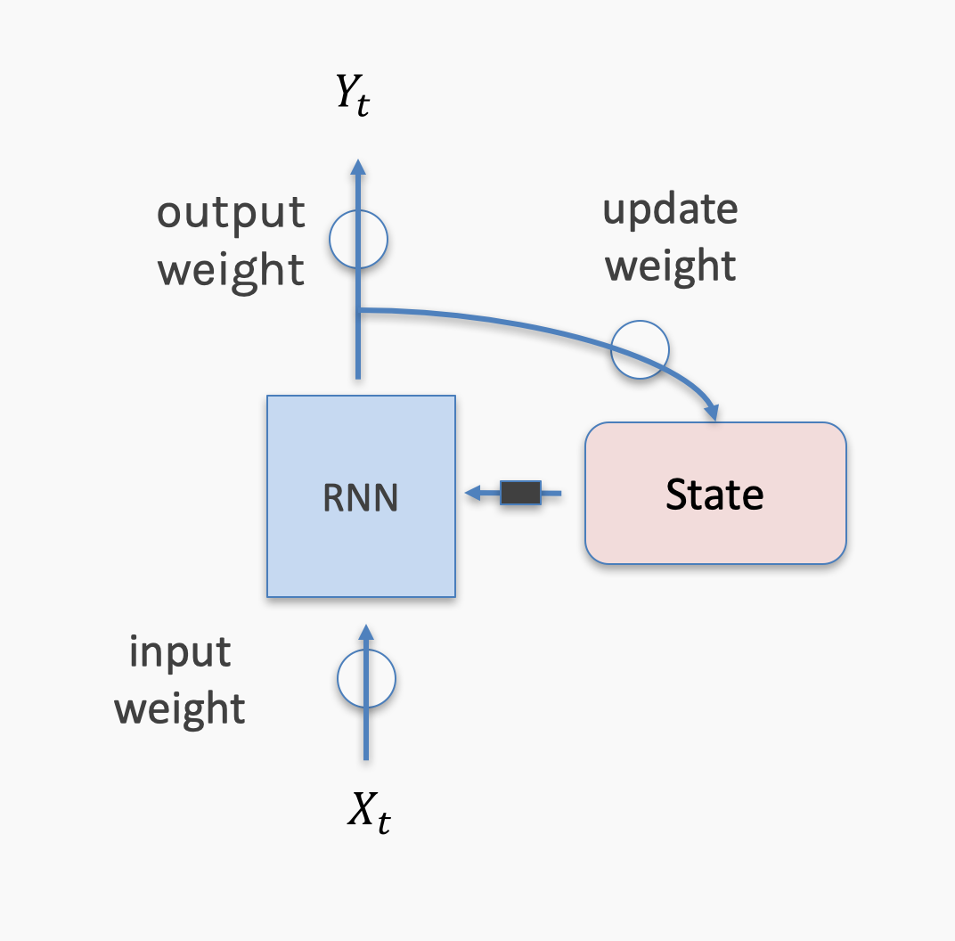
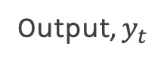
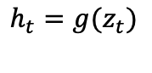
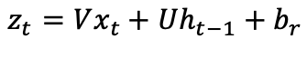
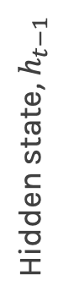
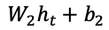
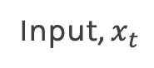
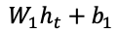
Output, $y_{t}$
Anatomy of an RNN unit
activation
activation
$$W_{1}h_{t}+b_{1}$$
$$W_{2}h_{t}+b_{2}$$
W₁
W₂
U
activation
$$h_{t}=g(z_{t})$$
Hidden state, $h_{t−1}$
$$z_{t}=Vx_{t}+Uh_{t−1}+b_{r}$$
V
Input, $x_{t}$

Slide 4
Long-term Dependencies
Unfolded networks can be very deep
Long-term interactions are given exponentially smaller weights than small-term interactions
Gradients tend to either vanish or explode

Slide 5
Long Short-Term Memory
Handles long-term dependencies
Leaky units where weights on self-loop α is context-dependent
Allow network to decide whether to accumulate or forget past info

Slide 6
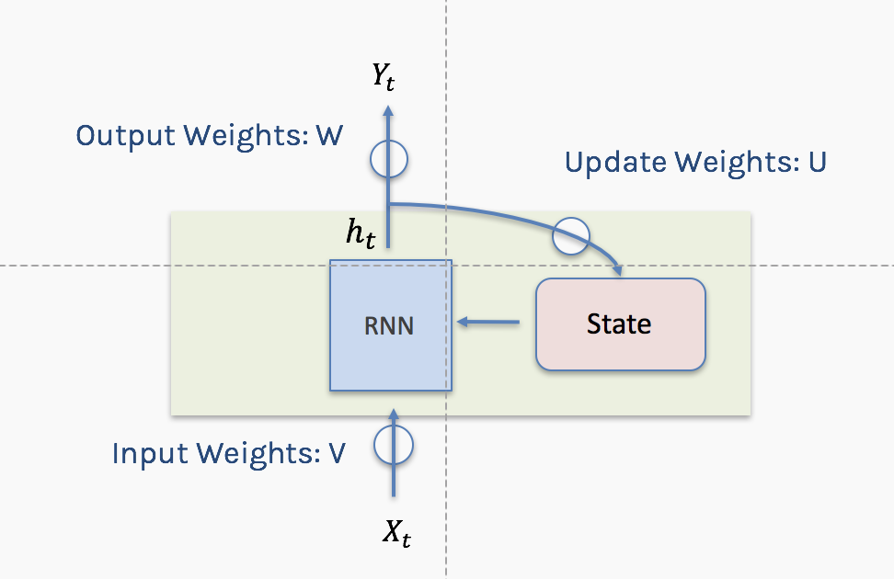
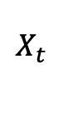
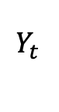
Notation
Using conventional and convenient notation
$$Y_{t }$$
$$X_{t }$$

Slide 7
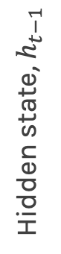
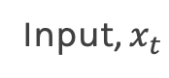
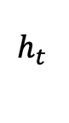
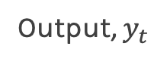
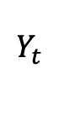
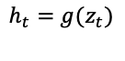
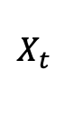
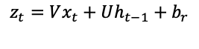
Simple RNN again
Output, $y_{t}$
$$Y_{t }$$
activation
activation
$$W_{1}h_{t}+b_{1}$$
$$W_{2}h_{t}+b_{2}$$
σ
W₁
W₂
W
U
activation
$$h_{t}=g(z_{t})$$
$$h_{t }$$
State
Hidden state, $h_{t−1}$
$$z_{t}=Vx_{t}+Uh_{t−1}+b_{r}$$
σ
+
U
V
V
Input, $x_{t}$
$$X_{t }$$

Slide 8
Simple RNN again
Output, $y_{t}$
$$Y_{t }$$
activation
activation
$$W_{1}h_{t}+b_{1}$$
$$W_{2}h_{t}+b_{2}$$
σ
W₁
W₂
W
U
activation
$$h_{t}=g(z_{t})$$
$$h_{t }$$
State
Hidden state, $h_{t−1}$
$$z_{t}=Vx_{t}+Uh_{t−1}+b_{r}$$
σ
+
U
V
V
Input, $x_{t}$
$$X_{t }$$

Slide 9

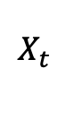
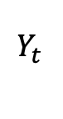
Simple RNN again: Memories
$$Y_{t }$$
σ
W
$$h_{t }$$
State
σ
+
U
V
$$X_{t }$$

Slide 10
Simple RNN again: Memories - Forgetting
$$Y_{t }$$
σ
W
$$h_{t }$$
State
σ
+
U
V
$$X_{t }$$

Slide 11
Simple RNN again: New Events
$$Y_{t }$$
σ
W
$$h_{t }$$
State
σ
+
U
V
$$X_{t }$$

Slide 12
Simple RNN again: New Events Weighted
$$Y_{t }$$
σ
W
$$h_{t }$$
State
σ
+
U
V
$$X_{t }$$

Slide 13
Simple RNN again: Updated memories
$$Y_{t }$$
σ
W
$$h_{t }$$
State
σ
+
U
V
$$X_{t }$$

Slide 14
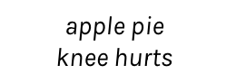
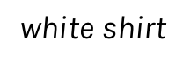
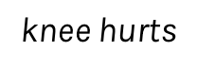
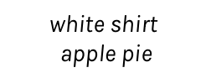
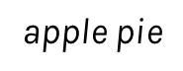
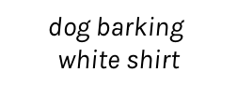
RNN + Memory
A naïve way of remembering/forgetting and updating is to remember the latest n inputs.
Example: Is it raining? Build an RNN to estimate the probability of raining :
0.3
0.1
0.1
0.4
0.6
-------
-------
-------
dog barking
$$\text{dog} \text{barking}$$
$$\text{white} \text{shirt}$$
$$\text{white} \text{shirt}$$
$$\text{apple} \text{pie}$$
$$\text{apple} \text{pie}$$
$$\text{knee} \text{hurts}$$
RNN
RNN
RNN
RNN
RNN
dog barking
$$\text{white} \text{shirt}$$
$$\text{apple} \text{pie}$$
$$\text{knee} \text{hurts}$$
gets dark

Slide 15
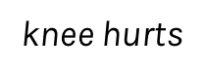
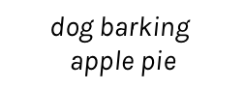
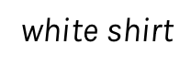
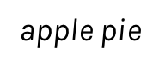
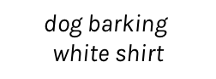
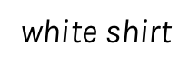
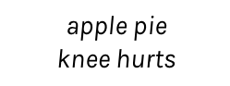
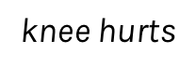
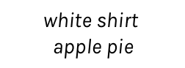
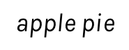
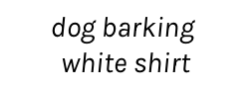
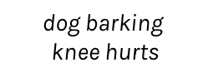
RNN + Memory (cont) – A better scheme
0.3
0.1
0.1
0.4
0.6
-------
-------
-------
dog barking
$$\text{dog} \text{barking}$$
$$\text{white} \text{shirt}$$
$$\text{white} \text{shirt}$$
$$\text{apple} \text{pie}$$
$$\text{apple} \text{pie}$$
$$\text{knee} \text{hurts}$$
RNN
RNN
RNN
RNN
RNN
dog barking
$$\text{white} \text{shirt}$$
$$\text{apple} \text{pie}$$
$$\text{knee} \text{hurts}$$
gets dark
0.3
0.1
0.1
0.6
0.9
-------
-------
-------
dog barking
$$\text{dog} \text{barking}$$
$$\text{white} \text{shirt}$$
$$\text{dog} \text{barking}$$
$$\text{apple} \text{pie}$$
$$\text{dog} \text{barking}$$
$$\text{knee} \text{hurts}$$
RNN
RNN
RNN
RNN
RNN
dog barking
$$\text{white} \text{shirt}$$
$$\text{apple} \text{pie}$$
$$\text{knee} \text{hurts}$$
gets dark

Slide 16
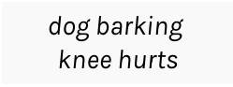
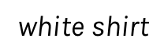
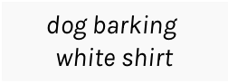
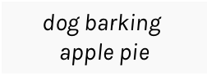
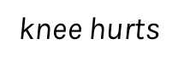
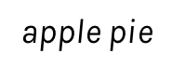
RNN + Memory + Output
0.3
0.1
0.1
0.6
0.9
-------
-------
-------
dog barking
$$\text{dog} \text{barking}$$
$$\text{white} \text{shirt}$$
$$\text{dog} \text{barking}$$
$$\text{apple} \text{pie}$$
$$\text{dog} \text{barking}$$
$$\text{knee} \text{hurts}$$
RNN
RNN
RNN
RNN
RNN
dog barking
$$\text{white} \text{shirt}$$
$$\text{apple} \text{pie}$$
$$\text{knee} \text{hurts}$$
gets dark

Slide 17

LSTM: Long short term memory
It looks kind of complicated but we will dissect it.

Slide 18
Gates
A key idea in the LSTM is a mechanism called a gate.

Slide 19
Forgetting
Each value is multiplied by a gate, and the result is stored back into the memory.

Slide 20
Remembering
Remembering involves two steps.
We determine how much of each new value we want to remember and we use gates to control that.
Remember the gated values, we merely add them in to the existing contents of the memory.

Slide 21
Updating
To select from memory we just determine how much of each element we want to use, we apply gates to the memory elements, and the results are a list of scaled memories.

Slide 22
LSTM
LSTM again. Find the differences compared to a simple RNN.
$$Y_{t }$$
Introduce the cell state
σ
W
C_{t-1}
C_{t}
$$h_{t }$$
State
σ
+
U
h_{t-1}
h_{t}
V
Hidden state is updated considering the cell state.
Crazy things happen here
$$X_{t }$$
Notes:
Finite state machines

Slide 23
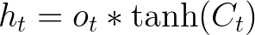
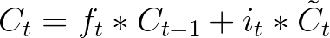
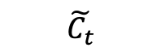
Before we dive in to really understand LSTM, lets see the big picture …
Forget Gate
C_{t-1}
C_{t}
Output Gate
f_{t}
i_{t}
o_{t}
$$\tilde{C_{t}}$$
h_{t-1}
h_{t}
Input Gate
Cell State

Slide 24
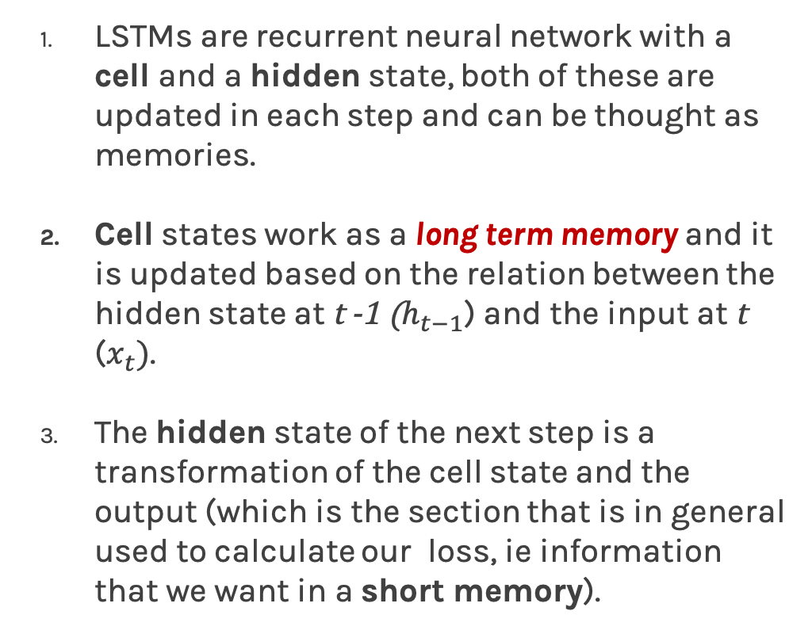
LSTM: Big picture
LSTMs are recurrent neural network with a cell and a hidden state, both of these are updated in each step and can be thought as memories.
Cell states work as a long term memory and it is updated based on the relation between the hidden state at t -1 ($h_{t−1}$) and the input at t ($x_{t})$.
The hidden state of the next step is a transformation of the cell state and the output (which is the section that is in general used to calculate our loss, ie information that we want in a short memory).
h_{t-1}

Slide 25
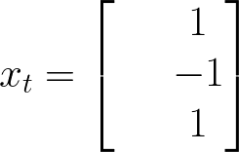








Let's think about my cell state
Family situation
Mood
Enviroment
Busy
Schedule
Let's predict if I will help you in the homework in time t.

Slide 26









Forget Gate
The forget gate tries to estimate what features of the cell state should be forgotten.
Erase everything!

Slide 27










The input gate layer works in a similar way as the forget layer. The input gate layer estimates the degree of confidence of and $i_{t}×\tilde{C_{t}}$ is a new estimation of the cell state.
Input Gate
Let’s say that my input gate estimation is:
i_{t}
$$\tilde{C_{t}}$$

Slide 28

Cell state
After the calculation of forget gate and input gate we can update our cell state.
28

Slide 29






Output gate
The output gate layer is calculated using the information of the input at time t ($x_{t}$) and hidden state of the last step ($h_{t−1}$).
It is important to notice that hidden state used in the next step is obtained using the output gate layer, which is usually the function that we optimize.

Slide 30







wcct! = we can calculate this!
To optimize my parameters we basically need to do:
Let’s calculate all the derivatives in some time t!
wcct!
wcct!
wcct!
wcct!
So… every derivative is wrt the cell state or the hidden state

Slide 31



Let’s calculate the cell state and the hidden state

Slide 32


Slide 33
GRU
A variant of the LSTM is called the Gated Recurrent Unit, or GRU.
The GRU is like an LSTM but with some simplifications.
The forget and input gates are combined into a single gate
No cell state
Since there’s a bit less work to be done, a GRU can be a bit faster than an LSTM. It also usually produces results that are similar to the LSTM.
Note: Worthwhile to try both the LSTM and GRU to see if either provides more accurate results for a data set.

Slide 34


GRU (cont)
C_{t-1}
C_{t}
i_{t}
o_{t}
f_{t}
$$\tilde{C_{t}}$$
h_{t-1}
h_{t}

Slide 35

RNN Structures
$$Y_{t }$$
The one to one structure is useless.
It takes a single input and it produces a single output.
Not useful because the RNN cell is making little use of its unique ability to remember things about its input sequence
$$X_{t }$$
one to one

Slide 36


RNN Structures (cont)
$$Y_{t }$$
﻿The many to one structure reads in a sequence and gives us back a single value.
Example: Sentiment analysis, where the network is given a piece of text and then reports on some quality inherent in the writing. A common example is to look at a movie review and determine if it was positive or negative.
$$X_{t−2 }$$
$$X_{t−1 }$$
$$X_{t }$$
many to one

Slide 37




RNN Structures (cont)
$$Y_{t−2 }$$
$$Y_{t−1 }$$
$$Y_{t }$$
The one to many takes in a single piece of data and produces a sequence.
For example we give it the starting note for a song, and the network produces the rest of the melody for us.
$$X_{t−2 }$$
one to many

Slide 38


RNN Structures (cont)
$$Y_{t−2 }$$
$$Y_{t−1 }$$
$$Y_{t }$$
﻿The many to many structures are in some ways the most interesting. ﻿used for machine translation.
Example: Predict if it will rain given some inputs.
$$X_{t−2 }$$
$$X_{t−1 }$$
$$X_{t }$$
many to many

Slide 39
RNN Structures (cont)
$$Y_{t−1 }$$
$$Y_{t }$$
This form of many to many can be used for machine translation.
For example, the English sentence: “The black dog jumped over the cat”
In Italian as:
“Il cane nero saltò sopra il gatto”
In the Italia, the adjective “nero” (black) follows the noun “cane” (dog), so we need to have some kind of buffer so we can produce the words in their proper English.
$$X_{t−2 }$$
$$X_{t−1 }$$
many to many

Slide 40
Bidirectional
LSTM and RNN are designed to analyze sequence of values.
For example: ﻿Patrick said he needs a vacation.
he here means Patrick and we know this because Patrick was before the word he.
However consider the following sentence:
He needs to work more, Pavlos said about Patrick.
Bidirectional RNN or BRNN or bidirectional LSTM or BLSTM when using LSTM units.

Slide 41





Bidirectional (cond)
$$Y_{t−2 }$$
$$Y_{t−1 }$$
$$Y_{t }$$
﻿symbol for a BRNN
$$Y_{t }$$
previous state
previous state
$$X_{t }$$
$$X_{t−2 }$$
$$X_{t−1 }$$
$$X_{t }$$

Slide 42
Deep RNN
LSTM units can be arranged in layers, so that each the output of each unit is the input to the other units. This is called a deep RNN, where the adjective “deep” refers to these multiple layers.
Each layer feeds the LSTM on the next layer
First time step of a feature is fed to the first LSTM, which processes that data and produces an output (and a new state for itself).
That output is fed to the next LSTM, which does the same thing, and the next, and so on.
Then the second time step arrives at the first LSTM, and the process repeats.

Slide 43







Deep RNN
$$Y_{ }$$
$$Y_{t−2 }$$
$$Y_{t−1 }$$
$$Y_{t }$$
$$Y_{t+1 }$$
$$Y_{t+2 }$$
$$X_{ }$$
$$X_{t−2 }$$
$$X_{t−1 }$$
$$X_{t }$$
$$X_{t+1 }$$
$$X_{t+2 }$$

Slide 44
Skip Connections
Add additional connections between units d time steps apart
Creating paths through time where gradients neither vanish or explode
t-1
t
t+1

Slide 45
Leaky Units
Linear self-connections
Maintain cell state: running average of past hidden activations

Slide 46

Standard RNN
colah.github.io

Slide 47
Leaky Unit
✕
colah.github.io

Slide 48
Sequence to Sequence
Sebastien lived in France.
Seq2seq model learns from variable sequence input fixed length sequence output. It uses two LSTM model, one learns vector representation from input sequence of fixed dimensionality and another LSTM learns to decode from this input vector to target sequence.

Slide 49

Sequence to Sequence (cont)

Slide 50
What is Teacher Forcing (cont)
Models that have recurrent connections from their outputs leading back into the model may be trained with teacher forcing.
— Page 372, Deep Learning, 2016.
Teacher forcing is a procedure […] in which during training the model receives the ground truth output y(t) as input at time t + 1.
— Page 372, Deep Learning, 2016.

Slide 51
What is Teacher Forcing (cont)
Given the following input sequence:
“The wheels on the bus go round and round.”
In this task we want to train a model to generate the next word in the sequence given the previous sequence of words.
We add a token to signal the start of the sequence and another to signal the end of the sequence. We will use “[START]” and “[END]” respectively.
“[START] The wheels on the bus go round and round [END]

Slide 52
What is Teacher Forcing (cont)
Imagine the model generates the word “A“, but of course, we expected “The“.
The model is off track and is going to get punished for every subsequent word it generates. This makes learning slower and the model unstable.
Instead, we can use teacher forcing.
In the first example when the model generated “A” as output, we can discard this output after calculating error and feed in “The” as part of the input on the subsequent time step.

Slide 53
What is Teacher Forcing (cont)
In the first example when the model generated “A” as output, we can discard this output after calculating error and feed in “The” as part of the input on the subsequent time step.
[START], ?
[START], The, wheels ?
[START], The, wheels, on , ?
[START], The, wheels, on , the, ?
...
REMEMBER: ONLY IN TRAINING TIME

Slide 54

Notes:
LiveSlide Site
https://blog.openai.com/better-language-models/

Slide 55
Attention models
Sebastien lived in France.
Back in Sebastien’s days at France, he lived in the city of Paris, a city of great beauty and filled with love and beautiful art, and he spoke French, a language with great history and the national language of France.
Back in Sebastien’s days at France, =>
he lived in the city of Paris, =>
a city of great beauty and filled with love and beautiful art, =>
and he spoke French, a language with great history and the national language of France.

Slide 56

Attention models
When translating a sentence, you pay attention to the word that is presently translated.
When transcribing an audio recording, you listen carefully to the segment you are actively writing down.
To describe the room you are in, you describe the objects in that room.
https://distill.pub/2016/augmented-rnns/

Slide 57
Attention models (cont)
This attention is generated with content-based attention. The attending RNN generates a query describing what it wants to focus on. Each item is multiplied (dot product) with the query to produce a score, describing how well it matches the query. The scores are fed into a softmax to create the attention distribution.
Source – https://github.com/google/seq2seq

Slide 58

Attention models (cont)

Slide 59
Notes:
LiveSlide Site
https://distill.pub/2016/augmented-rnns/

